Slide 1
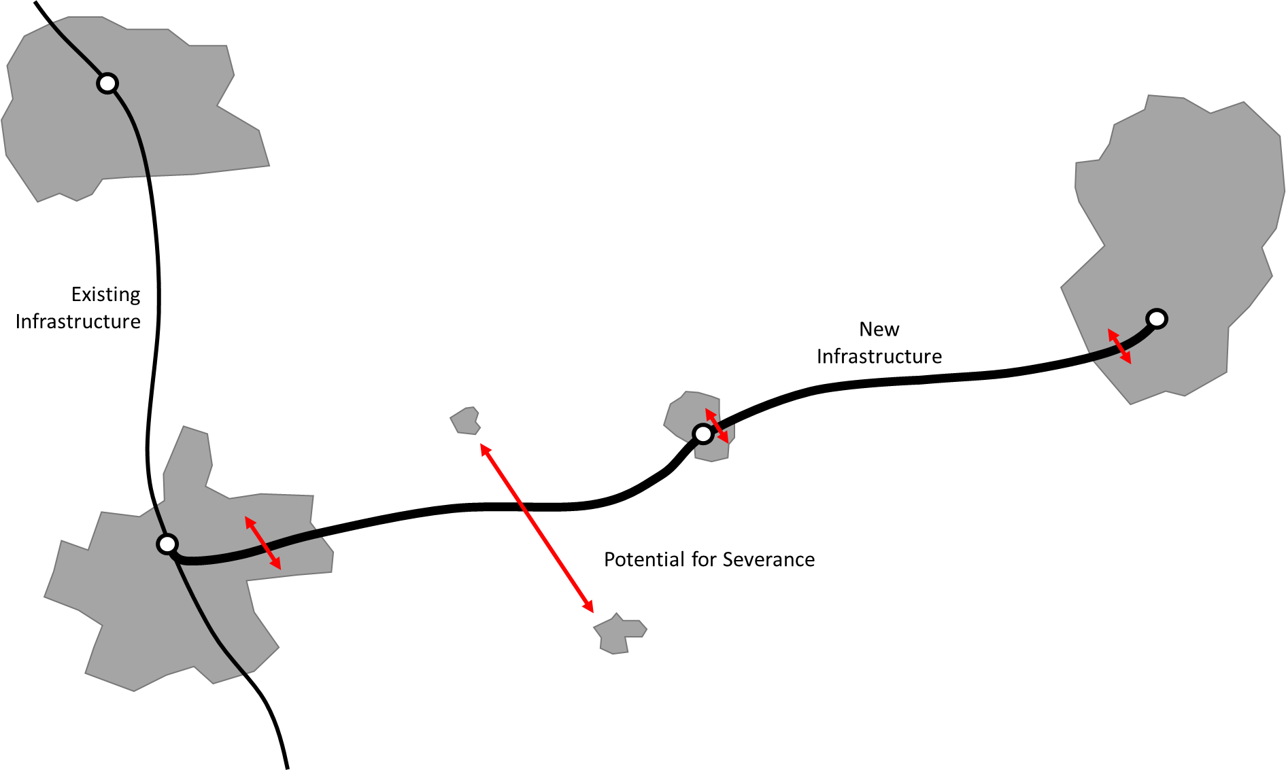
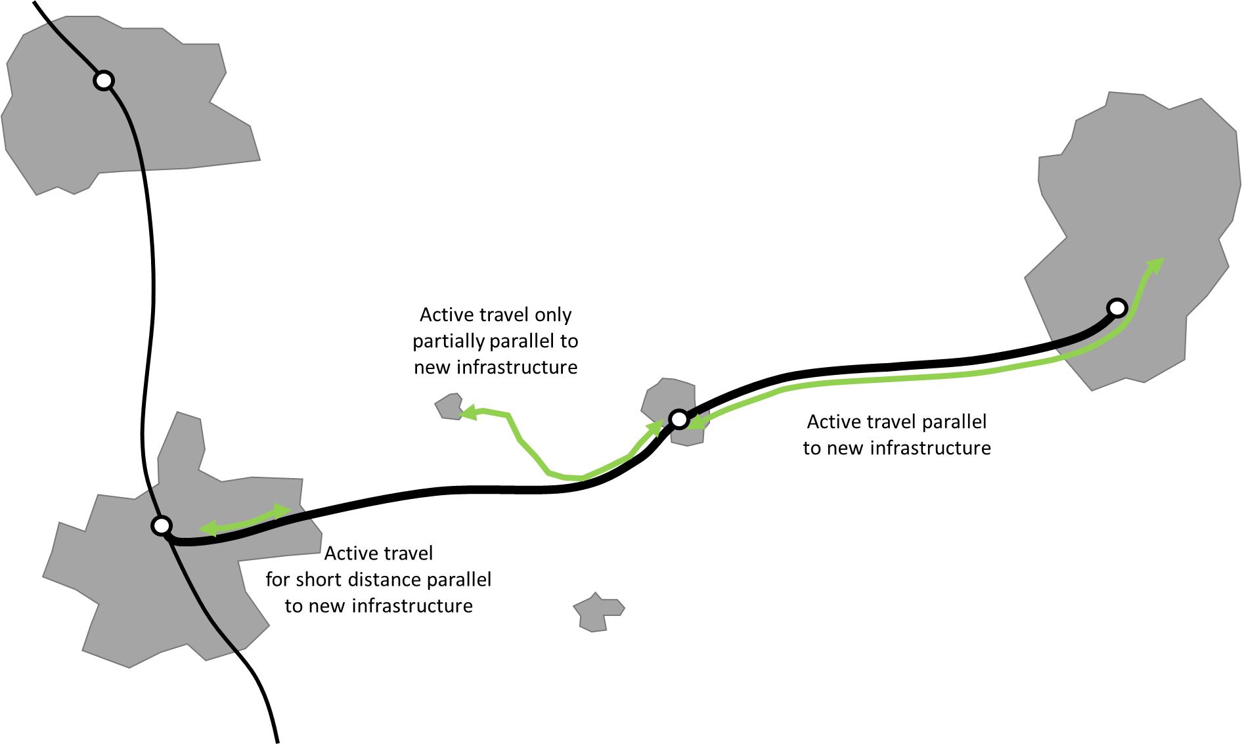
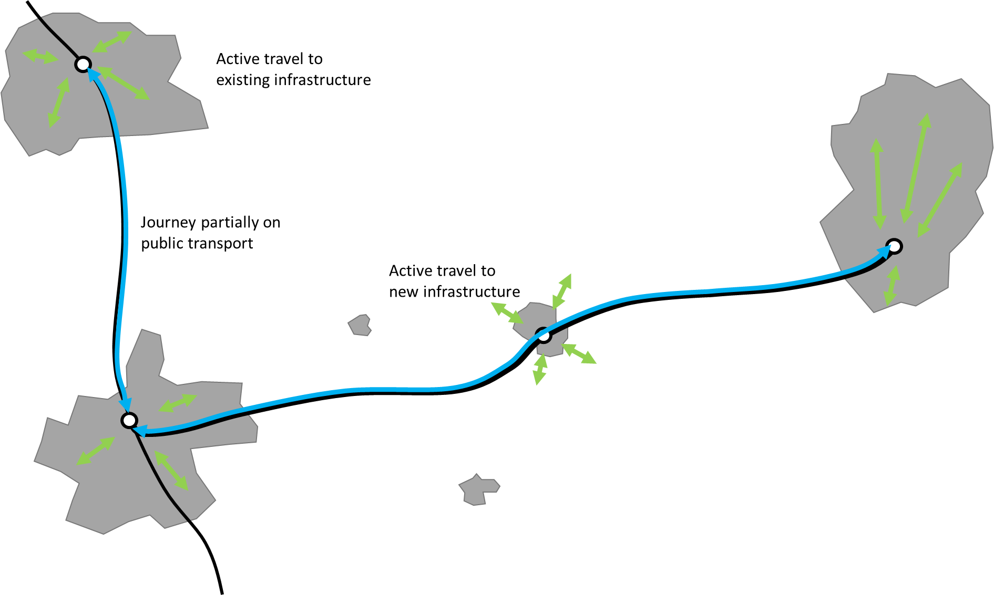
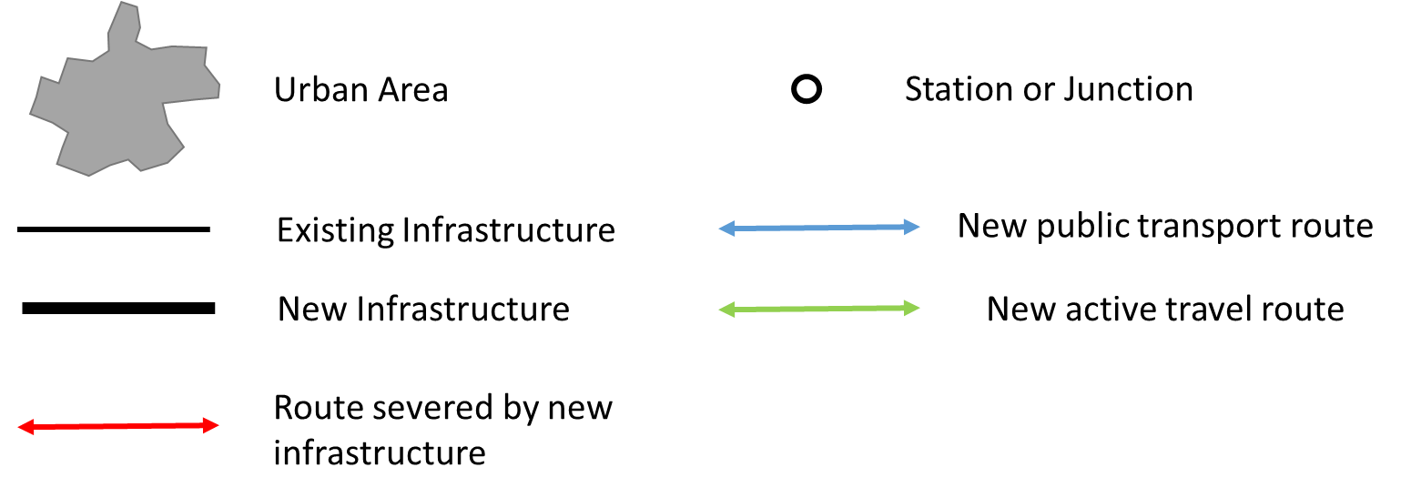

Slide 2
Existing Infrastructure
New Infrastructure
Potential for Severance

Slide 3
Urban Area
Station or Junction
Existing Infrastructure
New public transport route
New Infrastructure
New active travel route
Route severed by new infrastructure

Slide 4
Active travel only partially parallel to new infrastructure
Active travel parallel to new infrastructure
Active travel
for short distance parallel to new infrastructure

Slide 5
Active travel to
existing infrastructure
Journey partially on public transport
Active travel to
new infrastructure

